Slide 1

IT 353 Web Development Technologies
Jianwei Lai
jlai12@ilstu.edu

Slide 2
Content for Today
JavaScript basics
Function
HTML DOM
In-class practice 2

Slide 3
What is JavaScript
Created by Brendan Eich in 1995 for Netscape Navigator 2 release. Called Mocha and later LiveScript.
On release of 1.1 name was changed to JavaScript.
JavaScript allows for interactivity
Browser/page manipulation
Reacting to user actions
http://www.csc.villanova.edu/~map/1020/javascript.ppt

Slide 4
The Three Layers of the Web
HTML for Content
<p class=“warning”>There is no <em>download link</em> on this page.</p>
CSS for Presentation
.warning { color: red; }
JavaScript for Behavior
document.getElementById("demo").innerHTML = "Hello JavaScript";
https://www.w3schools.com/js/tryit.asp?filename=tryjs_intro_inner_html
https://www.w3schools.com/js/tryit.asp?filename=tryjs_intro_lightbulb

Slide 5
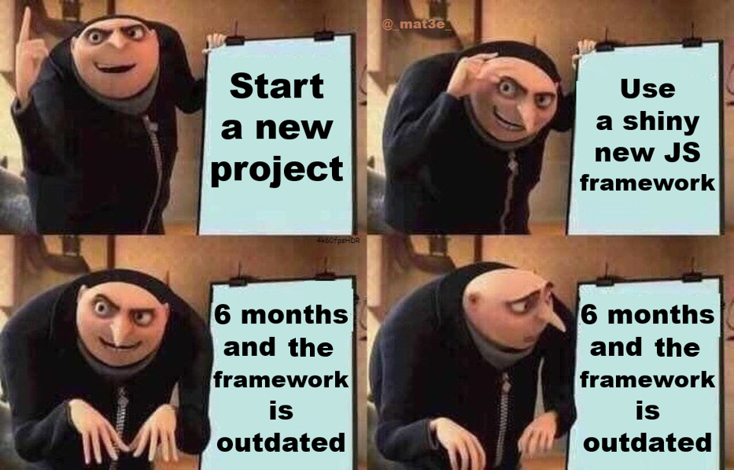
Top 12 Most Important JavaScript Frameworks for 2021
1. Angular-JS (Front-end)
2. React.JS (Front-end)
3. Vue.js (Front-end)
4. Ember.js (Front-end)
5. Meteor.js (Back-end)
6. Backbone.js (Front-end)
7. Express (Back-end)
8. Aurelia.js (Front-end)
9. Polymer.js (Front-end)
10. Next.js (Back-end)
11. Mithril.js
12. Webix

Slide 6
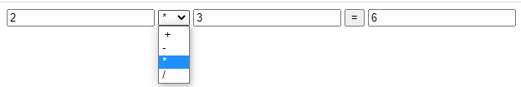
JavaScript Allows Interactivity Example
<script>
function fun(){
var one=document.getElementById('one').value;
var two=document.getElementById('two').value;
var symbol=document.getElementById('symbol').value;
var result=eval(one+symbol+two);
document.getElementById('result').value=result;
}
</script>
Notes:
https://blog.csdn.net/qq_41140741/article/details/81508603
<!DOCTYPE html>
<html lang="en">
<head>
<meta charset="UTF-8">
<title>a.html</title>
</head>
<body>
<script>
function fun(){
var one=document.getElementById('one').value;
var two=document.getElementById('two').value;
var symbol=document.getElementById('symbol').value;
var result=eval(one+symbol+two);
document.getElementById('result').value=result;
}
</script>
<input type="text" id='one' />
<select id='symbol'>
<option value='+'>＋</option>
<option value='-'>-</option>
<option value='*'>*</option>
<option value='/'>/</option>
</select>
<input type='text' id='two' />
<input type='button' value='=' onclick=fun() />
<input type='text' id='result' />
</body>
</html>

Slide 7
How Does JavaScript Work?
Embedded within HTML page
Executes on client
Fast, no connection needed once loaded
Simple programming statements combined with HTML tags
Notes:
JavaScript is embedded/included within HTML. You can often see JavaScript in the source of a web page or it is provided for information on the page as with the calculator example.
JavaScript is mainly used as a client-side language - it downloads with the web page. Once the page has downloaded and is on the users' machine, it is actually the web browser which then interprets the JavaScript instructions. JavaScript pages run quickly, you are not relying on an internet connection to a web server. Short pieces of JavaScript can be combined with HTML without the need to develop a fully blown program.
There are two types of computer language, compiled and interpreted. To write or edit a compiled language requires a special piece of software called a compiler. JavaScript belongs to the other category, called interpreted. In the case of JavaScript, this interpretation is done by the browser software at run-time. Because JavaScript is interpreted, this means that no special tools are required to write or edit JavaScript, just a normal text editor. JavaScript web pages can be platform independent i.e. they will run on different browsers and computers (as long as the browser is JavaScript enabled).

Slide 8
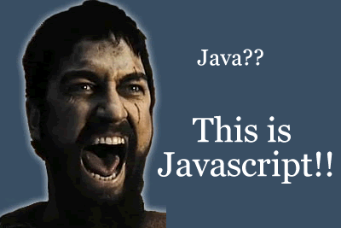
JavaScript vs Java
Totally different
A full programming language
Much harder!
A compiled language
Independent of the web
Sometimes used together
Notes:
Java is often confused with JavaScript. JavaScript was originally called LiveScript, but due to the popularity of Java at the time, it was renamed JavaScript . Java is different from JavaScript in a number of significant areas:
Java is a full programming language which can do just about anything - JavaScript isn't and can only do relatively simple things.
Java is much harder to learn and takes much longer to master.
Java is compiled. The language is not 'embedded' or written in the page - it is self-contained as a separate file.
Java can be used/written totally independently from the web - JavaScript works with web browsers only.
They are sometimes used together - JavaScript can be used to 'control' or configure Java 'applets'.

Slide 9
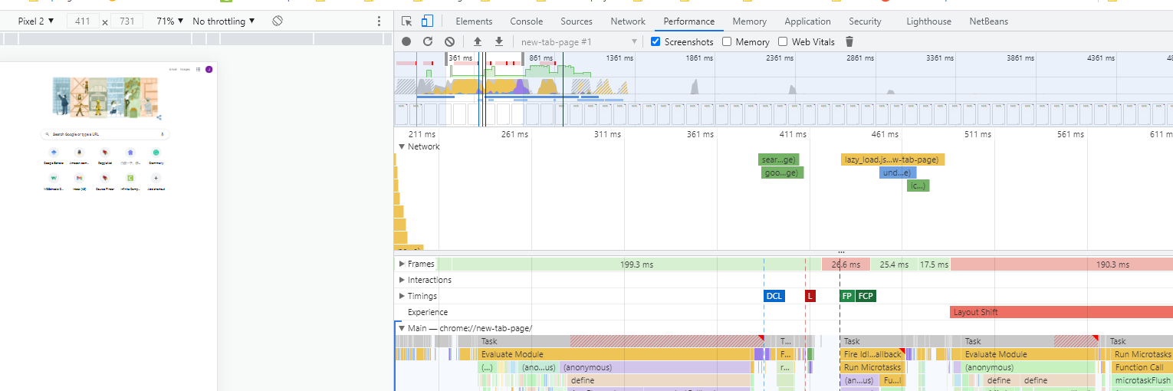
Right Click-> Inspect->Check Performance to see when JavaScript files are loaded

Slide 10
Page Rendering and Script
When the browser renders an HTML-page and finds a <script> tag - it switches into Javascript mode and executes the code inside. Once executed the browser continues rendering the rest of the page.

Slide 11
Try to see the difference
<!DOCTYPE html>
<html>
<head>
<title>Introduction to Javascript</title>
</head>
<body>
<div id="demo">
</div>
<script>
document.getElementById("demo").innerHTML="Hello Javascript";
</script>
</body>
</html>
<!DOCTYPE html>
<html>
<head>
<title>Introduction to Javascript</title>
<script>
document.getElementById("demo").innerHTML="Hello Javascript";
</script>
</head>
<body>
<div id="demo">
</div>
</body>
</html>

Slide 12
Where to Add JavaScript
A script can be put anywhere on the page. The most useful places include:
Inside the Head tag of the document
At the bottom of the document, right before closing BODY
But, generally scripts can be put anywhere.
http://javascript.info/tutorial/adding-script-html

Slide 13
Where to Put Script
If you want a script to execute early, before the page is displayed, then the HEAD section is a good place.
<html>
<head>
<script>
…
</script>
</head>
<body>
<h2>Press the button to start</h2>
….
</body>
</html>
Notes:
Any potential issue？
Loading time & Check the example on page 10.

Slide 14
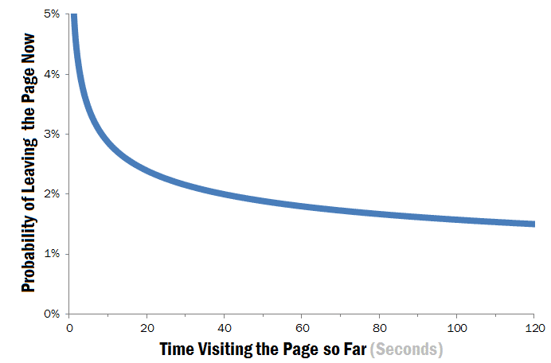
Where to Put Script
A script can also be at the bottom of page body.
It executes after the page is shown.
Cons: functions become available after the HTML is loaded. A user has a chance to click on button which may not work.
Usually adding special code that hides functionality until the script has loaded resolves the problem.
Pros: user doesn’t have to wait for scripts.
onload event---The browser has finished loading the page
Notes:
Any potential issue of putting at the bottom?

Slide 15
How to solve the problem with the onload event?
<!DOCTYPE html>
<html>
<head>
<title>Introduction to Javascript</title>
<script>
document.getElementById("demo").innerHTML="Hello Javascript";
</script>
</head>
<body>
<div id="demo">
</div>
</body>
</html>

Slide 16
<!DOCTYPE html>
<html>
<head>
<title>Introduction to Javascript</title>
<script>
function welcomeMessage(){
document.getElementById("demo").innerHTML="Hello Javascript";
}
</script>
</head>
<body onload=“welcomeMessage()”>
<div id="demo">
</div>
</body>
</html>

Slide 17
Function
JavaScript provides different ways of defining functions:
Function Declaration
Function Expression
https://www.youtube.com/watch?v=LI-0ilvrvYk

Slide 18
Function Declaration
function sum(a, b) {
return a+b;
}
var result = sum(2,5);
alert(result);
function sayHi(name) {
alert("Hi, "+name);
}
sayHi('John');
const x = function (a, b) {return a * b};

Slide 19
Variables
Names can contain letters, digits, underscores, and dollar signs.
Names must begin with a letter
Names can also begin with $ and _
Names are case sensitive (y and Y are different variables)
Reserved words (like JavaScript keywords) cannot be used as names
var
let
const
https://www.w3schools.com/js/tryit.asp?filename=tryjs_variables_add_numbers
https://www.w3schools.com/js/tryit.asp?filename=tryjs_variables_redefine

Slide 20
let
Variables defined with let cannot be Redeclared.
Variables defined with let must be Declared before use.
Variables defined with let have Block Scope.
Block Scope: Variables declared inside a { } block cannot be accessed from outside the block
let x = "John Doe"; let x = 0; // SyntaxError: 'x' has already been declared
https://www.w3schools.com/js/tryit.asp?filename=tryjs_es6_let
Notes:
Change let to var to see the difference
Get rid of {} to see the error in console
Declare x last. Change it to let to see the difference
<script>
x = 10;
// Here x is 10
document.getElementById("demo").innerHTML = x;
var x;
// Here x is 10
</script>

Slide 21
const
Variables defined with const cannot be Redeclared.
Variables defined with const cannot be Reassigned.
Variables defined with const have Block Scope.
https://www.w3schools.com/js/tryit.asp?filename=tryjs_const_array_assign
https://www.w3schools.com/js/tryit.asp?filename=tryjs_const_array

Slide 22
Function Invocation
When an event occurs (when a user clicks a button)
When it is invoked (called) from JavaScript code
Automatically (self invoked)

Slide 23
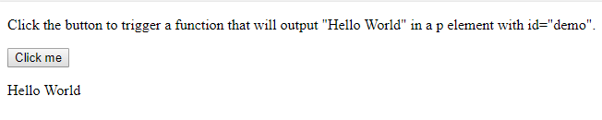
<!DOCTYPE html>
<html>
<body>
<p>Click the button to trigger a function that will output "Hello World" in a p element with id="demo".</p>
<button onclick="myFunction()">Click me</button>
<p id="demo"></p>
<script>
function myFunction() {
document.getElementById("demo").innerHTML = "Hello World";
}
</script>
</body>
</html>
https://www.w3schools.com/jsref/tryit.asp?filename=tryjsref_onclick
Notes:
Try with <body onload="myFunction()"> instead of <button onclick="myFunction()">Click me</button>

Slide 24
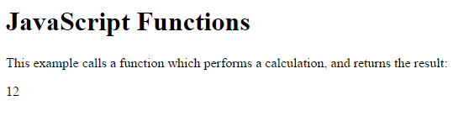
<!DOCTYPE html>
<html>
<body>
<h1>JavaScript Functions</h1>
<p>This example calls a function which performs a calculation, and returns the result:</p>
<p id="demo"></p>
<script>
function myFunction(a, b) {
return a * b;
}
document.getElementById("demo").innerHTML = myFunction(4, 3);
</script>
</body>

Slide 25
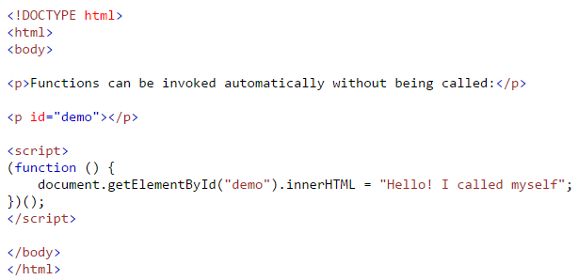

(function () { // I will invoke myself })();

Slide 26
Will “Hello Javascript” be on the screen?
<!DOCTYPE html>
<html>
<head>
<title>Introduction to Javascript</title>
</head>
<body >
<div id="demo">
</div>
<script>
function welcomeMessage(){
document.getElementById("demo").innerHTML="Hello Javascript";
}
</script>
</body>
</html>
Notes:
Get rid of function welcomeMessage() {} to see if it works

Slide 27
Will “Hello Javascript” be on the screen?
<!DOCTYPE html>
<html>
<head>
<title>Introduction to Javascript</title>
</head>
<body>
<div id="demo">
</div>
<script>
(function(){
document.getElementById("demo").innerHTML="Hello Javascript";
})();
</script>
</body>
</html>

Slide 28
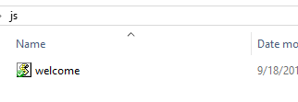

External Script
<!DOCTYPE html>
<html>
<head>
<title>Introduction to Javascript</title>
</head>
<body >
<div id="demo">
</div>
<script src="js/welcome.js"></script>
</body>
</html>
External scripts block page rendering in same way as embedded scripts do.
So, if an external script is in HEAD then the page will not be shown until the script is downloaded and executed.
Notes:
Any benefit of using an external script

Slide 29
HTML DOM (Document Object Model)
The HTML DOM defines a standard set of objects for HTML, and a standard way to access and manipulate HTML documents
All HTML elements, along with their containing text and attributes, can be accessed through the DOM.
The contents can be modified or deleted, and new elements can be created.
The HTML DOM is platform and language independent
It can be used by any programming language like Java, JavaScript, and VBScript
https://www.youtube.com/watch?v=SObk1cPul5Y
http://miageprojet2.unice.fr/@api/deki/files/1333/=JavaScript.pdf

Slide 30
Document Object: Write text to the output
<html>
<body>
<script type="text/javascript">
document.write("Hello World!")
</script>
</body>
</html>
<html>
<body>
<script type="text/javascript">
document.write("<h1>Hello World!</h1>")
</script>
</body>
</html>

Slide 31
Document Object: Use getElementById()
<html>
<head>
<script type="text/javascript">
function getElement() {
var x=document.getElementById("myHeader")
alert("I am a " + x.tagName + " element")
}
</script>
</head>
<body>
<h1 id="myHeader" onclick="getElement()">Click to see what element I am!</h1>
</body>
</html>

Slide 32
Document Object: Use getElementsByName()
<html>
<head>
<script type="text/javascript">
function getElements() {
var x=document.getElementsByName("myInput")
alert(x.length + " elements!")
}
</script>
</head>
<body>
<input name="myInput" type="text" size="20"><br />
<input name="myInput" type="text" size="20"><br />
<input name="myInput" type="text" size="20"><br />
<br />
<input type="button" onclick="getElements()" value="How many elements named
'myInput'?">
</body>
</html>
The name attribute specifies the name of an <input> element.
The name attribute is used to reference elements in a JavaScript, or to reference form data after a form is submitted.
Note: Only form elements with a name attribute will have their values passed when submitting a form.
https://www.w3schools.com/jsref/tryit.asp?filename=tryjsref_doc_getelementsbyname_length

Slide 33
getelementsbyclassname
https://www.w3schools.com/jsref/tryit.asp?filename=tryjsref_document_getelementsbyclassname2

Slide 34
Document Object:
Access an item in a collection
<html>
<body>
<form id="Form1" name="Form1">
Your name: <input type="text">
</form>
<form id="Form2" name="Form2">
Your car: <input type="text">
</form>
<p>
To access an item in a collection you can either use the number or the name of the item:
</p>
<script type="text/javascript">
document.write("<p>The first form's name is: " + document.forms[0].name + "</p>")
document.write("<p>The first form's name is: " + document.getElementById("Form1").name
+ "</p>")
</script>
</body>
</html>

Slide 35
Event Object: What are the
coordinates of the cursor?
<html>
<head>
<script type="text/javascript">
function show_coords(event) {
x=event.clientX
y=event.clientY
alert("X coords: " + x + ", Y coords: " + y)
}
</script>
</head>
<body onmousedown="show_coords(event)">
<p>Click in the document. An alert box will alert the x and y coordinates of the
cursor.</p>
</body>
</html>

Slide 36
Event Object: What is the unicode of the key pressed?
<html>
<head>
<script type="text/javascript">
function whichButton(event) {
alert(event.keyCode)
}
</script>
</head>
<body onkeyup="whichButton(event)">
<p><b>Note:</b> Make sure the right frame has focus when trying this example!</p>
<p>Press a key on your keyboard. An alert box will alert the unicode of the key
pressed.</p>
</body>
</html>

Slide 37
Event Object: Which event type occurred?
<html>
<head>
<script type="text/javascript">
function whichType(event) {
alert(event.type);
}
</script>
</head>
<body onmousedown="whichType(event)">
<p>
Click on the document. An alert box will alert which type of event occurred.
</p>
</body>
</html>

Slide 38
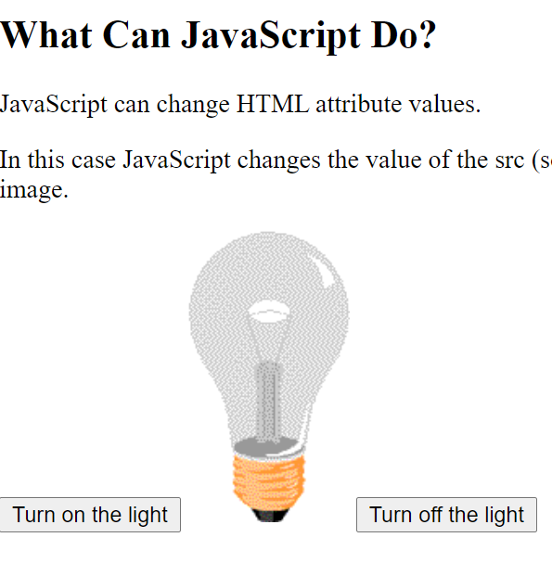
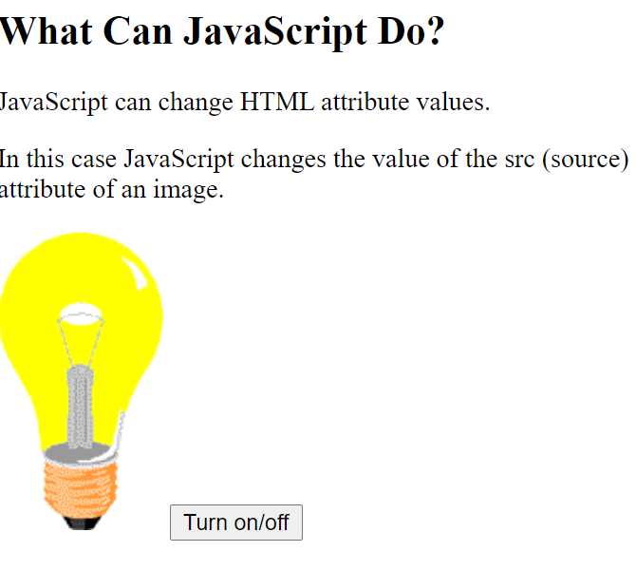
Turn on/off with one button
https://www.w3schools.com/js/tryit.asp?filename=tryjs_intro_lightbulb
Notes:
<!DOCTYPE html>
<html>
<body>
<h2>What Can JavaScript Do?</h2>
<p>JavaScript can change HTML attribute values.</p>
<p>In this case JavaScript changes the value of the src (source) attribute of an image.</p>
<!--<button onclick="document.getElementById('myImage').src='pic_bulbon.gif'">Turn on the light</button>
document.getElementById('myImage').src='pic_bulboff.gif'-->
<img id="myImage" src="pic_bulboff.gif" style="width:100px">
<button onclick="swith()">Turn on/off </button>
<script>
function swith(){
var src = document.getElementById('myImage').getAttribute("src");
if (src =="pic_bulbon.gif"){
document.getElementById('myImage').src='pic_bulboff.gif';
} else {
document.getElementById('myImage').src='pic_bulbon.gif';
}
}
</script>
</body>
</html>

Slide 39
In-class practice 2 -Control the zombie with arrow keys-due 9-15
Requirements: press arrow keys on the keyboard, the zombie will move to the corresponding directions.
A reference to HTML 5 game https://www.youtube.com/watch?v=riUx2G75mas&t=1648s
Notes:
Feel free to add new things, （optional, not requirement for the practice)
such as
Add a background to the game
Add some other objects such as brains to let the zombie eat to gain a score
Display the game score
Increase the score whenever a brain is eaten
add some other things that the zombie should avoid, such as flying bombs
Make it fun

Slide 40

Challenges of moving the zombie with arrow keys
Make the window listener to key events
Check which arrow key is pressed
Move the zombie when an arrow key is pressed

Slide 41
Make the window listener to key events
….
<body onload="docReady()"> <!-- a web page has completely loaded all content (e.g., images, CSS files...). for example. a video needs to be loaded-->
<h1 id = "message">This is a scary zombie</h1>
<div id ="zombie" style="position:absolute; left:50px; top:50px"; ></div> <!-- initial position of the zombie-->
</body>
</html>

Slide 42
Create <script>..</script>
<!DOCTYPE html>
<html>
<head>
<title>Zombie</title>
<link rel="stylesheet" type="text/css" href="css/styles.css">
<script > /*JavaScript codes need to be within the script tags, you can use an external .js file*/
…
</script>
</head>
…

Slide 43
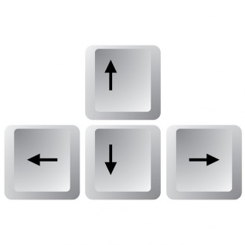
1. Make the window listener to key events
<script /*JavaScript codes need to be within the script tags*/
function docReady()
{
window.addEventListener('keydown', moveZombie);
/*eventListner can tell a key is pressed, and then call the function moveZombie*/
}
</script>

Slide 44
2. Check which arrow key is pressed
function moveZombie(evt) { /* create a function call it moveZombie*/
switch (evt.keyCode) { /*keyCode is used to identify which key is pressed*/
case 37: /* the keyCode for the Left Arrow key is 37*/
leftArrowPressed(); /* call the function leftArrowPressed()*/
break; /* stop here*/
}
}

Slide 45
3. Move the zombie when an arrow key is pressed
function leftArrowPressed() { /*define a function and call it leftArrowPressed()*/
var zombie = document.getElementById('zombie'); /*find the zombie div by ID */
zombie.style.left = parseInt(zombie.style.left) - 10 + 'px';
/*when left Arrow Pressed move the zombie 10 px to the left*/
}
Notes:
Var zombie need to be defined with a function, otherwise it won’t work.

Slide 46
1
<body onload="docReady()">
window.addEventListener('keydown', moveZombie);
2
function leftArrowPressed() {
var zombie = document.getElementById('zombie');
zombie.style.left = parseInt(zombie.style.left) - 10 + 'px';
}
function moveZombie(evt) {
switch (evt.keyCode) {
case 37: leftArrowPressed();
break;
}
3

Slide 47

Challenge for you
Move the zombie with the right, up, and down keys
case 39:
rightArrowPressed();
break;
case 38:
upArrowPressed();
break;
case 40:
downArrowPressed();
break;
function rightArrowPressed() {
zombie.style.left = parseInt(zombie.style.left) + 10 + 'px';
}
function upArrowPressed() {
zombie.style.top = parseInt(zombie.style.top) - 10 + 'px';
}
function downArrowPressed() {
zombie.style.top = parseInt(zombie.style.top) + 10 + 'px';
}

Slide 48
Finish the practice and submit to Reggienet

Slide 49
Before next class
Please read JavaScript tutorial basics on W3school
https://www.w3schools.com/js/default.asp

